Slide 1
VIT INTERNET BANKING WEBSITE
Developed by Ahmed and Roza

Slide 2
Goals of this project
A robust and effective web based online banking system.
Extending functionality without compromising security.
Personal banking services that gives you complete control over all your banking demands online.
Simple and easy user interface to work with.
Make a modular approach to web design so that extra functionalities can be added in future without disturbing other features.

Slide 3
Built with/Languages used
HTML5, CSS, JavaScript & jQuery used for front-end design.
PHP7 & MySQL used for back-end design.
Oracle MySQL has been used to create and host the database for the internet banking website.
Other than the languages/tools mentioned above NO other/external libraries and/or web-page templates have been used, everything has been coded from ground-up straight from scratch.

Slide 4
Features of the website
Based on intuitive modern material design by Google.
Fluid and responsive web design with cross device compatibility.
Cross compatibility with browsers, works on all browsers in the same way.
Optimized code to facilitate increased speed and fps while displaying the web-page.
And an Easter Egg, if you can find it !

Slide 5
Responsive Web Design
Associated files :
*navbar.php
(associated .css files)
Guidelines of RWD have been followed to ensure a seamless compatibility between different devices based on screen size. Elements which include the guidelines are :
Navbar : On large screens the contents of the navbar are present in a tabbed layout, however on small screens only one tab is visible and the rest become visible after clicking a button on the navbar.
The navbar is sticky in nature which means that on scrolling the page the navbar sticks to the top.

Slide 6
Associated files :
*sidebar.php,
header.php
(associated .css files)
Sidebar : On large screens the sidebar is always visible, however on small screens the navbar becomes visible only when an associated button (hamburger icon) is clicked on the navbar.
All the content of the web pages have been placed inside flex-boxes to ensure that they dynamically adjust with screen size.
Certain texts are replaced by icons to save space on small screen.
In certain places dynamic fonts have been coded, the size of which adjusts in accordance with the screen size.

Slide 7
Overview of the internet banking features :
Registration for online banking by Admin.
Adding beneficiary account by customer.
Transferring amount to the beneficiary added by customer.
Customers can check the transactions related with their account.
Customers can check their account statement within a date range.
Customers can filter their transactions based on certain variables.

Slide 8
Auto deletion of added beneficiaries on sensitive data mismatch or/if data integrity of the beneficiary is compromised.
Customer can debit/credit money from/into his/her account.
Customer can change their password and non sensitive details.
Admin can add/edit/delete customer.
Admin login page is hidden from customer for security purpose.
Admin can post news/notices on the main website.

Slide 9
Features of the database
The database contains customer & admin tables.
Each customer has its own virtual passbook linked with his/her account number.
Each customer has its own beneficiary table linked with his/her account number.
A separate table for news and news’ body is maintained in the database.

Slide 10
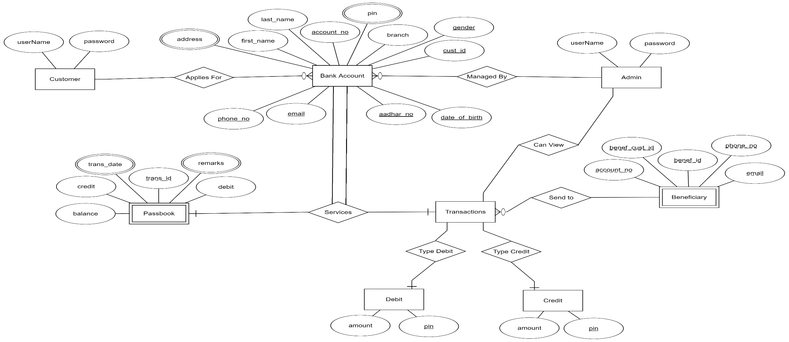
ER Diagram

Slide 11
Hierarchy of the website
Associated files :
admin_login*.php,
customer_login*.php
(associated .css files)
The website has been divided into 3 main parts :
A core home part where the customer can view login options, access contact information and/or read latest news/notices.
A core customer part where the customer can interact with the various options available to him/her for internet banking.
A core admin part where the admin can interact with the various options available to him/her for managing the customers and website.

Slide 12
The core home part
Associated files :
home.php,
news.php,
contact.php
(associated .css files)
It consists of 4 parts accessible via a top navigation bar :
Home : The home page of the website, also the login page for the customer.
News : This page consists of news/notices posted by the admin on the website.
Contact : This page has contact information about the bank.
About : About the bank and info regarding the developers of the website is present on this page.

Slide 13
The customer part
Associated files :
customer_home.php,
customer_profile*.php
(associated .css files)
This part is only accessible after the customer logs into his/her account. It cannot be accessed in any other way.
It consists of the following core internet banking features, most of them accessible via a side pane :
A Customer Home page which displays information about the customer like total balance, account number, last transaction, etc.
A My Profile page in which the customer can view/edit non sensetive details/change password and/or pin, etc.

Slide 14
Associated files :
customer_transactions.php
(associated .css files)
A My Transactions page which displays all the transactions of the customer in a tabular form. It consists of the following features :
Ability to sort the transactions by the transaction id or date of the transaction in both ascending and descending order.
Ability to filter the transactions based on a certain type of transaction/remark.
Ability to filter/display transactions within/from/up to a certain date range.
Ability to use one or more filter in conjugation with the other.
Ability to use filter in conjugation with sort type.
Filters being used are constantly displayed on the screen.
Ability to remove applied filters.

Slide 15
The customer can transfer funds to another customer via a Transfer Funds page which has the following features :
Before the customer can send funds, the customer has to add beneficiaries to whom he/she can send the funds.
Beneficiaries can be added via the transfer funds page. To add a beneficiary, the customer has to fill all the valid details as required in the add beneficiary form. Submitting invalid information will result in rejection of the form and the beneficiary can’t be added.
Beneficiaries can only be added if and only if ALL the information entered is valid.
After a beneficiary has been successfully added it will be displayed in the transfer funds page.
Associated files :
beneficiary.php,
add_beneficiary*.php
(associated .css files)

Slide 16
Associated files :
send_funds*.php (associated .css files)
The beneficiaries are displayed in a sequential card layout influenced by the material design. The customer can send funds to these beneficiaries or delete them.
The customer can search for a particular beneficiary among the list of his/her beneficiaries by both name and account number.
While transferring funds the customer has to authenticate the transfer by his online banking password.
If the transfer is invalid like <0 or >customers account balance the transfer will be rejected and an appropriate message will be given to the customer.
An important feature is auto deletion of beneficiaries discussed on the next slide.

Slide 17
Auto deletion of beneficiaries
Associated files :
verify_beneficiary.php,
auto_delete_beneficiary.php,
delete_beneficiary.php
(associated .css files)
Every time the “transfer funds” page loads a check is made initially to ensure that the data integrity of the beneficiaries is intact. If not, those beneficiaries whose data integrity has been compromised will be automatically deleted from the list of beneficiaries and an appropriate message will be displayed to the customer.
Data integrity of a beneficiary will be lost if and only if the following data of the beneficiary is changed :
email id, phone number, account number, name, and/or if the beneficiary’s account no longer exists.

Slide 18
Associated files :
atm_simulator*.php, (associated .css files)
A ATM Simulator page which the customer can use to debit/credit money from his/her account :
This feature is a “faux/display” feature only and is only used to stimulate real world scenario in which a customer interacts with an ATM to debit money or credit money.
This feature is NOT applicable for real internet banking websites.
For simulation purposes the customer has to enter a valid ATM pin to debit/credit money into his/her account.
The amount entered should also be valid, invalid amounts will result in rejection of the requests.

Slide 19
The admin part
Associated files :
admin_home.php,
post_news*.php
(associated .css files)
This part is accessible only after the admin logs into his/her account via a “hidden” login page for the admin. There is no other way to access the admin part without logging in first.
It consists of the following core admin features, most of them accessible via a side pane :
A Admin Home page which serves as a sort of greeting for the customer.
A Post News page through which the admin can post news/notices on the home part of the website.

Slide 20
Associated files :
customer_add*.php (associated .css files)
An Add Customer page through which the admin can add/create a new customer in the internet baking website database. The add customer form needs to be filled up carefully as any wrong input/data will result in rejection of the form and an appropriate error message will be displayed to the admin.
The admin holds absolute power over the customer’s details however he/she has no power over the customer’s transactions.

Slide 21
A Manage Customers page through which the admin can manage customers of the internet banking website. It has the following features :
The customers are displayed in a sequential card layout influenced by the material design. The admin can view/edit/update the details of these customers, view their transactions or delete them from the database.
The admin can search for a particular customer among the list of all the customers by both name and account number.
Associated files :
manage_customers.php
edit_customer*.php,
transactions.php
delete_customer.php,
(associated .css files)

Slide 22
Security features of the website
Each and every input is passed through mysqli_real_escape_string() to remove special characters from the string so that user can’t submit arbitrary input. It protects from attacks like SQL Injection and Cross Site Scripting(XSS).
Sensitive details like password/username in a form are passed through method=“POST” and NOT method=“GET” to prevent leak of such data via the URL.

Slide 23
Associated files :
validate_admin.php,
validate_customer.php
(associated .css files)
Customer/Admin can only enter into their accounts after entering their username and password via login.
Admin login page is hidden from customer for security purposes.
Before any page of the customer/admin part is displayed/loaded a check is made to ensure that the customer/admin session is valid and active (i.e. whether the customer/admin is logged into his/her session or not). If the session is invalid the user is redirected to the home page without notifying the user.
Thus accessing customer/admin pages after logging out, through history/using back button is impossible.

Slide 24
Associated files :
session_expired.php,
(associated .css files)
A session timeout feature is present for both the customer and the admin which ensures that if the website remains unused/no activity is detected by the user for >5 minutes, the user is automatically logged out and an appropriate message is displayed to the user informing him that his/her session has expired.
Care is taken to ensure that parallel/simultaneous sessions is not possible on the same system. In case such a situation happens, sessions active beside the current one will automatically die.
Admin can’t change his/her or the database’s password.

Slide 25
To do/Future scope
Make a customer grievance system where customer can interact with admin via messages to which the admins can respond appropriately. Much like a mail system between customer and admin.
Increase security of/in the website and web design, because honestly there is very little security as of now when compared to real world websites.
Add features/enhance already available features for internet banking.

